Slide 1
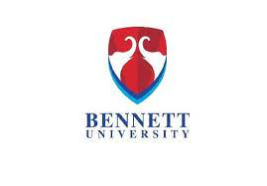
_
Progress Report of 1th Semester
(September- December ,2022)
Department of Computer Science Engineering (CSE)
BENNETT UNIVERSITY (Times of India Group)
Noida-201310
Topic of Project : NFT CREATIONS
Team Name : DATA PIRATES
Team Number: 211
Program: B.Tech (CSE)
Name of the Supervisors :
Presentation Date : 20th December,2022

Slide 2
NFT CREATIONS!
The need of this significant project would be –
To produce NFTs with the help of Python Language.
Which helps the person to understand how to make and understand the concept of NFTs with the help of Python.
They are helpful in production of Unique and different NFTs in a fraction of time.
Here it producing 7776 NFTs in less than 5 mins.

Slide 3
Introduction
What is NFT?
NFT means non-fungible tokens (NFTs), which are generally created using the same type of programming used for cryptocurrencies.
In simple terms these cryptographic assets are based on blockchain technology. They cannot be exchanged or traded equivalently like other cryptographic assets
Key Features of NFT -
Digital Asset - NFT is a digital asset that represents Internet collectibles like art, music, and games with an authentic certificate created by blockchain technology that underlies Cryptocurrency.
Unique - It cannot be forged or otherwise manipulated.
Exchange - NFT exchanges take place with cryptocurrencies such as Bitcoin on specialist sites.
Overview:-
We will tell and show the production of NFT and how to form NFTs which are unique and are produced in fraction of time

Slide 4
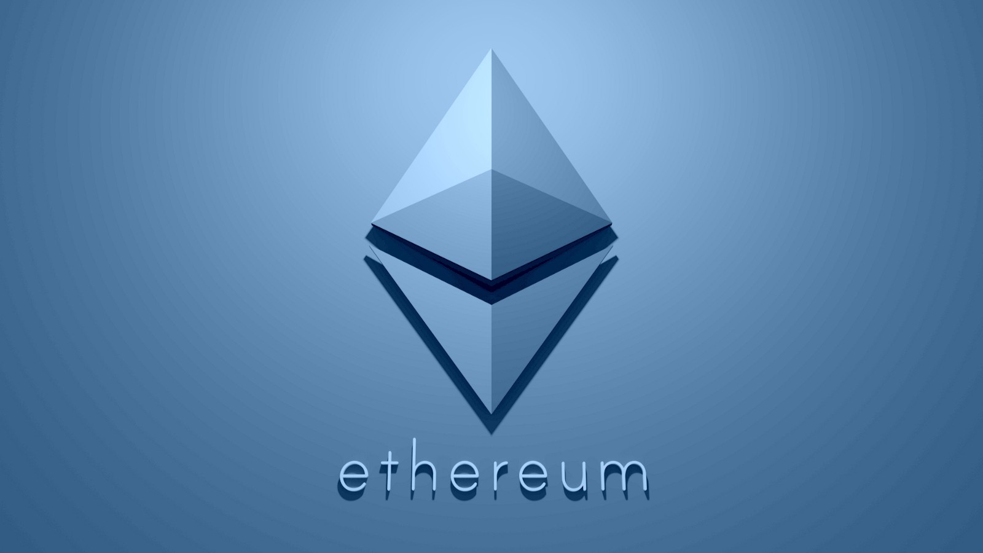
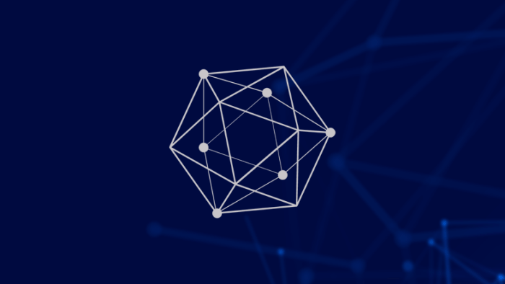
WHAT IS A BLOCKCHAIN
A blockchain is “a distributed database that maintains a continuously growing list of ordered records, called blocks.”
These blocks “are linked using cryptography. Each block contains a cryptographic hash of the previous block, a timestamp, and transaction data.
The top Blockchains in todays world are-
Ethereum
One Ledger
1ETH equal ₹97,009INR
1 One Ledger equals ₹0.26 INR

Slide 5
Importance of NFT?
Security: Everyone is looking forward to increased security for their digital assets. Fortunately, NFTs offer unparalleled safety and security. You can be confident of long-term fraud protection thanks to blockchain.
Unparalleled Market Efficiency: NFTs’ purpose is to increase market efficiencies, including when dealing with cryptocurrency.
These devices would enable you to turn physical assets into digital ones in an ideal world, eradicating intermediaries and streamlining supply chains.
Also, you’ll need better positioning to interact with cryptocurrency buyers or sellers easily.
Uses of NFTs?
NFTs are digital files. They can be a jpeg of a piece of art, real estate, or a video. Turning files into NFTs helps secure them via blockchain to make buying, selling and trading efficient, reducing fraud considerably

Slide 6
Future Benefits of NFT?
As NFT's cannot be copied or stolen as they are purchased to a specific buyer so they are reserved or you may say they represent one specific holder of it in the MetaVerse which is the futuristic block chain world for civilizational aspects.
Why do we need coding for NFT ??
We don't necessarily need coding for production of NFT's !!
But if we use it ,that’s is mainly due to thsese three crucial points which are-
Time consuming and hectic
Variations and Uniqueness
Production can be according to user
It also complies all the NFTs in a specific folder to see all the NFTs.

Slide 7
DRAWBACKS OF THIS PROJECT
Drawbacks of this project would be –
You would need to provide art in layers to this specific code to make NFTs .Which are provided by artist as the have to prepare the collection of variable data structures like
BODY
EAR
EYES
FACE
To make the significant NFT to be produced .

Slide 8
FUTURE PLANS
The future plans of this project could be-
If we enhance our art and have proper funds for it we could publish it for sales and could potentially work in the cryptocurrency world.
With all due to points if we continue on bettering the art o make it look good with proper artist and programmers to even provide Passive Utilities provides with NFTs.
It could lead to potentially a NFTs / Crypto Business.

Slide 9
THANK YOU

